Slide 1


Interactive Learning Systems: Why now and how?
Alekh Agarwal
Microsoft Research

Slide 2
AI Desiderata
Intelligent Assistant
Conversational Agent
Self-Driving
Game Playing
…
All of these and many more, using a single approach
How to get there?

Slide 3
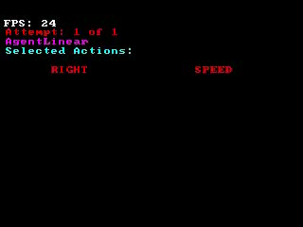
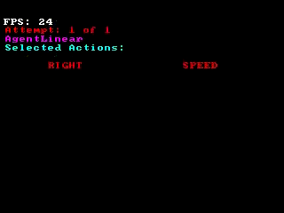

Supervised Learning
Gather labeled data, generalize to unseen examples
Does not work when agent interacts with its environment or other agents
Video credit: Stephane Ross

Slide 4
Interactive Learning
Observe the state of the world
Choose an action
Obtain feedback on the chosen action
Repeat
Goal: Optimize feedback (e.g. maximize reward) for chosen actions

Slide 5
Interactive Learning
Observe the state of the world
Choose an action
Obtain feedback on the chosen action
Repeat
Captures several learning settings:
No Teacher | Contextual Bandits | Reinforcement Learning
Teacher | Active Learning | Imitation Learning

Slide 6

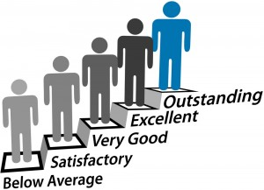
Outline of this talk
How to build interactive learning systems?
How to evaluate interactive learning systems?

Slide 7













Building an Interactive Learning System
Case study: Multi-World Testing Decision Service for Contextual Bandit Learning
Publicly available: http://aka.ms/mwt

Slide 8
Contextual Bandit Learning
Observe the state of the world (aka context)
Choose an action
Obtain feedback on the chosen action
Repeat
Goal: Optimize feedback (e.g. maximize reward) for chosen actions
Assumption: Agent’s actions do not influence future contexts

Slide 9
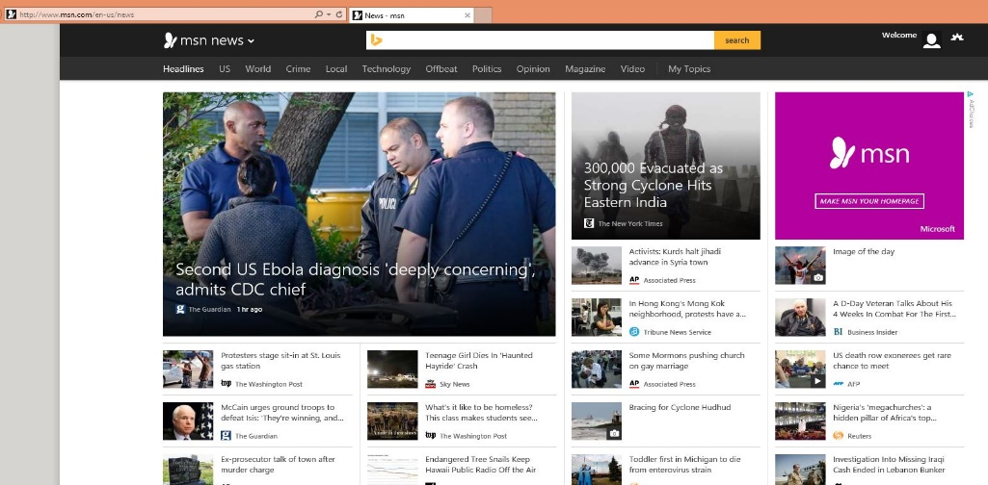
Example: News Recommendation
Loop:
1. User arrives at MSN with browsing history, user account, previous visits,…
2. Microsoft chooses news stories, ads, …
3. User responds to content (clicks/navigation,…)
Goal: Choose content to yield desired user behavior
CB Assumption: Recommendations to one user do not effect other users

Slide 10
Pervasive applications
Content Recommendation: Apps, Movies, Books, …
Personalization of search results
Churn prevention
Adaptive UI personalization
…
How to build a general purpose system to power all of them?

Slide 11
Key Properties
Feedback only on actions taken
Need to try every plausibly good action…
… for every context
Randomized choice of actions makes correct learning possible

Slide 12


Randomization
Recommendation Policy

Slide 13
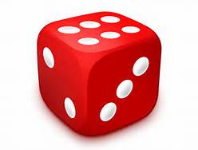
Randomization
Decision Service
Recommendation Policy

Slide 14

Randomization
Decision Service
Recommendation Policy
Need to record the probability of chosen action

Slide 15
Why it goes wrong
Separate teams for each part of the process
Faulty logging
Logging final action, not random choice
Logging just choice, not probabilities
Features not logged and change in time
Runtime behavior incompatible with the ML
Business logic overriding randomization
Using the probability as feature for downstream ML
Explore
Log
Deploy
Learn
Subtle errors that are difficult to find in complex systems!

Slide 16
Multiworld Testing Decision Service
any part of
Explore
Log
Deploy
Learn
Goal: Make this easy, fast, automated
General-purpose system
Without an ML person in the loop for some classes of applications
∧

Slide 17
Decision Service Gains on MSN

Slide 18
The service
Best model
context
Client Library
Online
Offline
App
decision
or
Learning
Learning
reward
Web API
Contexts
Decisions
Rewards
Join Server

Slide 19
The service
Explore
Best model
context
Client Library
Online
Offline
App
decision
or
Learning
Learning
reward
Web API
Contexts
Decisions
Rewards
Join Server

Slide 20
The service
Best model
context
Client Library
Online
Offline
App
decision
or
Learning
Learning
reward
Web API
Log
Contexts
Decisions
Rewards
Join Server

Slide 21
The service
Best model
Learn
context
Client Library
Online
Offline
App
decision
or
Learning
Learning
reward
Web API
Contexts
Decisions
Rewards
Join Server

Slide 22
The service
Deploy
Best model
context
Client Library
Online
Offline
App
decision
or
Learning
Learning
reward
Web API
Contexts
Decisions
Rewards
Join Server

Slide 23
The service
Best model
context
Client Library
Hyper-
Parameters
Online
Offline
App
decision
or
Learning
Features
Learning
reward
Web API
Contexts
Decisions
Training Data
Rewards
Join Server
Data

Slide 24
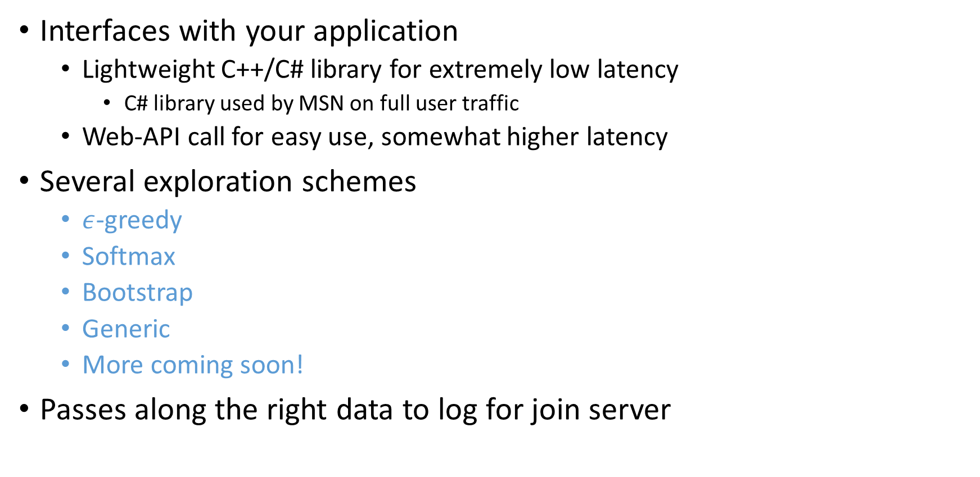
Client Library
Interfaces with your application
Lightweight C++/C# library for extremely low latency
C# library used by MSN on full user traffic
Web-API call for easy use, somewhat higher latency
Several exploration schemes
$ε$-greedy
Softmax
Bootstrap
Generic
More coming soon!
Passes along the right data to log for join server

Slide 25
public static void Run()
{
var recorder = new StringRecorder<Context>(); // Create an (optional) recorder.
var mwtt = new MwtExplorer<Context>("mwt", recorder);
var policy = new StringPolicy(); // Creates a policy that interacts with Context type
uint numActions = 10;
float epsilon = 0.2f;
// Creates an Epsilon-Greedy explorer using the specified settings
var explorer = new EpsilonGreedyExplorer<Context>(policy, epsilon, numActions);
// Creates a context of built-in Context type
var context = new Context(new Feature[] { new Feature() { Id = 1, Value = 0.5f }});
// Pass an instance of the Epsilon-Greedy exploration algorithm into MwtExplorer for exploration
// using a sample string to uniquely identify this event
string uniqueKey = "eventid";
uint action = mwtt.ChooseAction(explorer, uniqueKey, context);
Console.WriteLine(recorder.GetRecording());
}

Slide 26
Join Server
Joins together all data with the same key that arrives within the specified time window
Context, action and probability
Observed reward
(Optionally) other data to log
Implemented using Azure Stream Analytics

Slide 27
Semantics
Azure Storage
duration
duration
9
:
00
10
:
00
11
:
00
Events Key₁
Events Key₂

Slide 28
Learning
Existing contextual bandit algorithms for learning and evaluation
Evaluation: Given a policy, estimate its performance if deployed
Provides estimate of the performance of a policy upon deployment without deploying it!

Slide 29
Learning
Existing contextual bandit algorithms for learning and evaluation
Evaluation: Given a policy, estimate its performance if deployed
Optimization: Find a good policy from some set of policies given exploration data
Reduced to importance-weighted multiclass classification
Algorithms available in Vowpal Wabbit
Online as well as batch updates possible
Policy Optimization beyond the reach of A/B testing

Slide 30




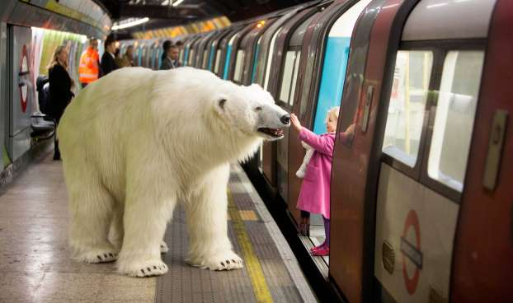
MSN Deployment for Personalized News
ɛ-greedy exploration
Clicks to join server in Azure
Ranked List
User demographics feature vector
User history feature vector
50 editorially chosen articles with feature vectors
User Clicks Story
…
Front End Server Client Brower

Slide 31


Slide 32
MSN Stats and Results
10s of millions of users
1000s of requests per second
5% overhead on front end machines
10s of servers for joining and training
5 minute model update frequency
> 25% increase in clicks
(without much tuning)
…

Slide 33
Outline of this talk
How to build interactive learning systems?
How to evaluate interactive learning systems?

Slide 34
Evaluating Interactive Learning Systems
Evaluation is hard for interactive learning tasks!
Different systems choose different actions, need to provide feedback
Training/Test paradigm not so obvious
Known techniques break down beyond Contextual Bandits
Reliable evaluation crucial to make steady progress
Even more challenging for General AI systems:
Requires suite of diverse tasks, learning settings, input modes, …

Slide 35
Project Malmo for AI experimentation
Research Team: Alekh Agarwal, Fernando Diaz, Urun Dogan, Miro Dudik, Katja Hofmann, Pushmeet Kohli, Nate Kushman, Lihong Li, Ewa Luger, Bhaskar Mitra, Robert Schapire, Evelyne Viegas
Core Platform Development: David Bignell, Tim Hutton
Interns & Visitors:, Felix Leibfried, Marlos Machado, Nisarg Mehta, Himanshu Sahni
Alumni: Dave Abel, Fraser Allison, Dilip Arumugam, Nicole Beckage, Diana Borsa, Roberto Calandra, Valli Chockalingam, Philip Geiger, Jose Hernandez-Orallo, Matthew Johnson, Lydia Liu, Cristina Matache, Mathew Monfort, Nantas Nardelli

Slide 36
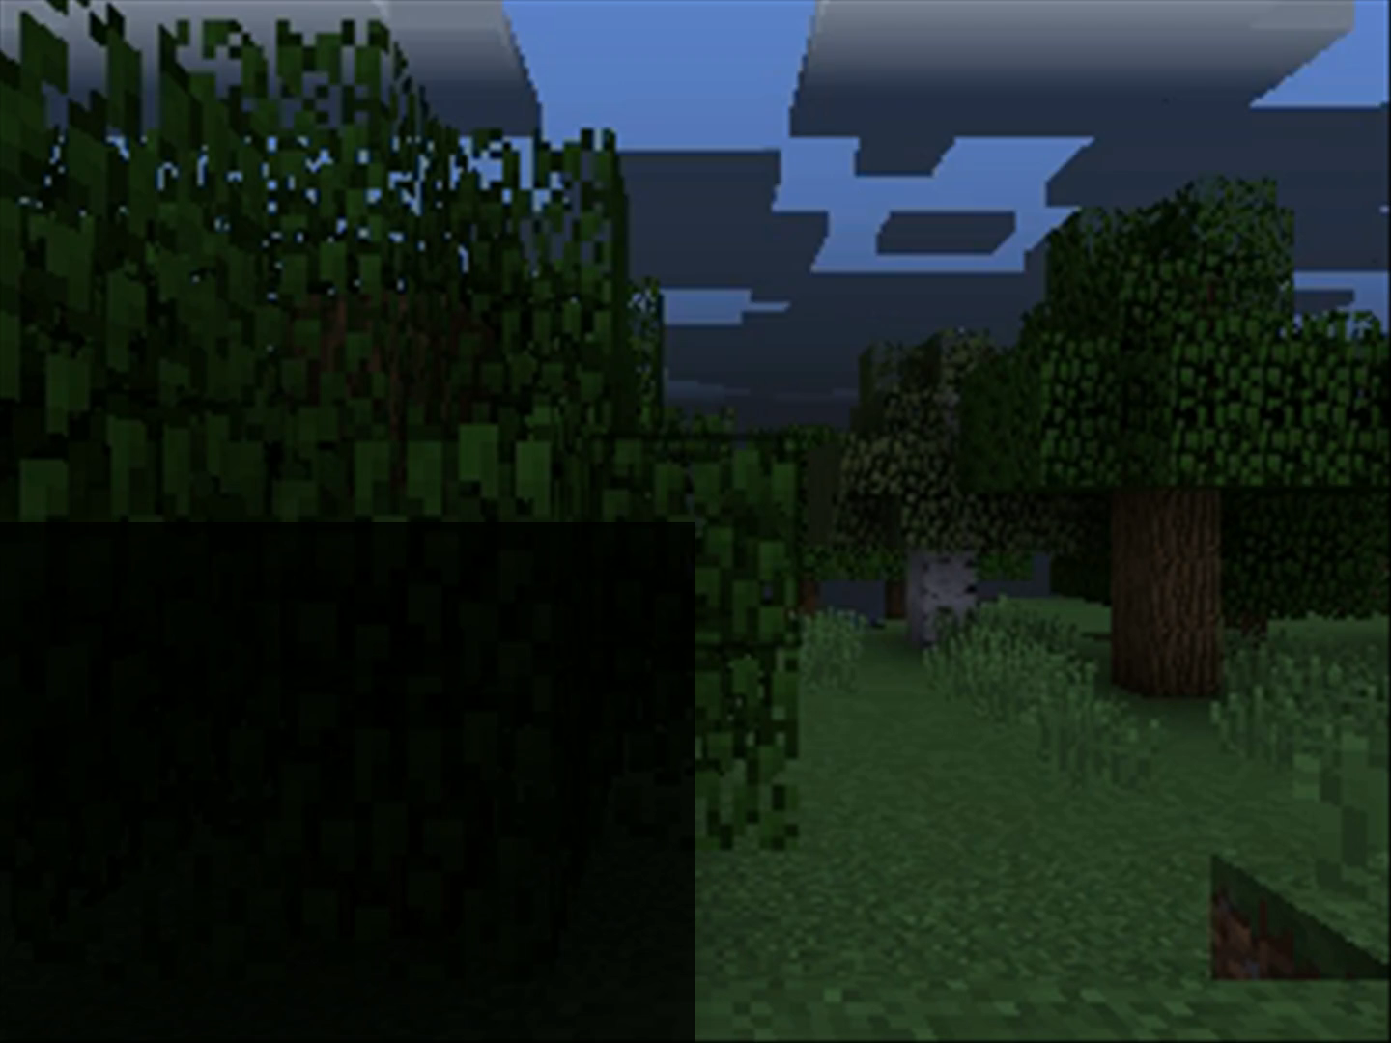
Minecraft 101
You (the player / agent)
… choose from an infinite variety of complex worlds
… experience the world from a 1st person perspective
… can interact with everything you see
… play in creative or survival mode
... play by yourself or with others (communicate, collaborate)

Slide 37
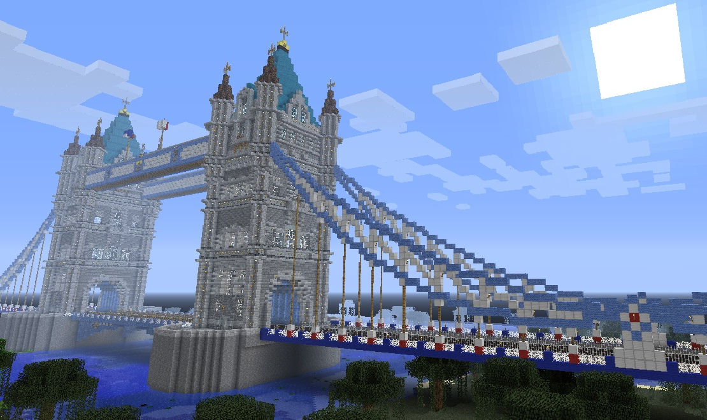
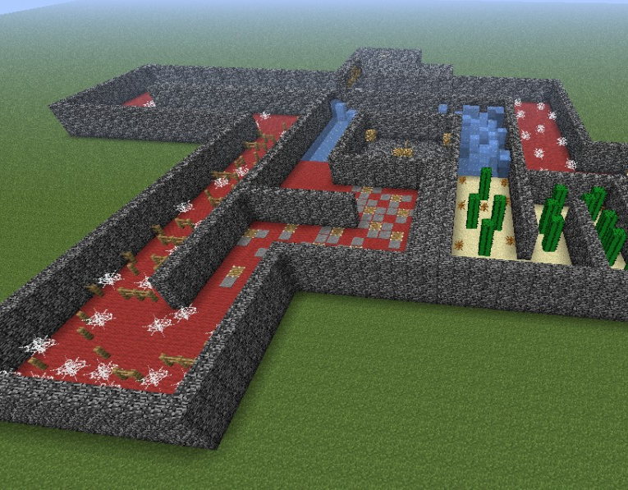
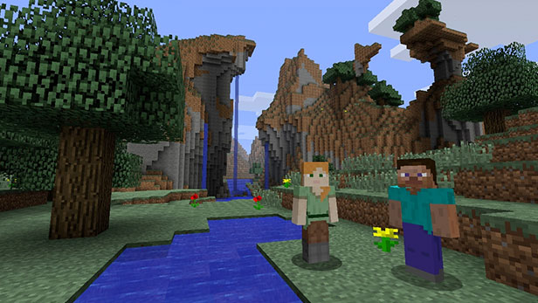
Minecraft for AI experimentation
An open-ended game where players explore, create, socialize – provides infinitely varied tasks for AI agents
Procedurally generated 3D worlds that (human and AI) players experience from a first-person perspective – easily generate large amounts of data that reflect complex, coherent physics
Needed: easily connect AI agents & tasks to run experiments, benchmark algorithms, reproduce results …

Slide 38
Use Cases and Design Principles (what and how)
Connect AI agents into the game through an intuitive yet powerful API
Provide researchers with tools for task creation – building on existing Minecraft capabilities
Build for extensions and novel uses – open source; “plug-and-play” design of observation, command, reward handlers
Low entry barrier: provide cross-language (currently: Java, .NET, C/C++, Python, Lua) & cross-platform (Windows, Linux, MacOS) API

Slide 39
Malmo = Minecraft Mod + API + tools
Minecraft (Client + Server)
API
The Malmo platform wraps the interaction with the mod, providing a clean interface (API) for developing AI agents. Typical interaction loop: receive observations and rewards, then send commands in real-time to react to changes in the simulation environment.
Mod
The mod runs within the Minecraft process, exposing state as observations and rewards and listening for commands.
Observations
Rewards
User Code
Defines: task, agent, experiment design, external resources, …
(Malmo currently includes a small set of example tasks & agents)
Commands

Slide 40
Use case 1: create a new task
Define environment, agent, start, end conditions in a mission XML file.
Diverse environments:
Weather, day-night cycles, …
Water, mountains, valleys, lava, …
…
Diverse inputs/actions:
Image, video, chat, …
Discrete/continuous actions
Custom reward handlers
<?xml version="1.0" encoding="UTF-8" standalone="no" ?> <Mission xmlns="http://ProjectMalmo.microsoft.com" xmlns:xsi="http://www.w3.org/2001/XMLSchema-instance"> <About> <Summary>Cliff walking mission based on Sutton and Barto. </Summary> </About>
<ServerSection>
<ServerInitialConditions> [...] </ServerInitialConditions>
<ServerHandlers> [...] </ServerHandlers>
</ServerSection>
<AgentSection mode="Survival">
<Name>Steve</Name>
<AgentStart> <Placement x="4.5" y="46.0" z="1.5" pitch="30" yaw="0"/> </AgentStart>
<AgentHandlers> [...] </AgentHandlers>
</AgentSection>
</Mission>

Slide 41
Mission XML
<?xml version="1.0" encoding="UTF-8" standalone="no" ?> <Mission xmlns="http://ProjectMalmo.microsoft.com" xmlns:xsi="http://www.w3.org/2001/XMLSchema-instance"> <About> <Summary>Cliff walking mission based on Sutton and Barto. </Summary> </About>
<ServerSection>
<ServerInitialConditions> [...] </ServerInitialConditions>
<ServerHandlers> [...] </ServerHandlers>
</ServerSection>
<AgentSection mode="Survival">
<Name>Steve</Name>
<AgentStart> <Placement x="4.5" y="46.0" z="1.5" pitch="30" yaw="0"/> </AgentStart>
<AgentHandlers> [...] </AgentHandlers>
</AgentSection>
</Mission>
Define environment, agent, start, end conditions.
Schema documentation: http://microsoft.github.io/malmo/0.17.0/Schemas/Mission.html

Slide 42
Mission XML - ServerInitialConditions
[...]
<ServerInitialConditions>
<Time>
<StartTime>6000</StartTime>
<AllowPassageOfTime>false</AllowPassageOfTime>
</Time>
<Weather>clear</Weather>
<AllowSpawning>false</AllowSpawning>
</ServerInitialConditions> [...]
High-level environment behaviour: time, weather, spawning mobs
Schema documentation: http://microsoft.github.io/malmo/0.17.0/Schemas/Mission.html

Slide 43
Mission XML
[...] <ServerHandlers>
<FlatWorldGenerator generatorString="3;7,220*1,5*3,2;3;,biome_1"/>
<DrawingDecorator> <!-- limits of our arena -->
<DrawCuboid x1="-2" y1="46" z1="-2" x2="7" y2="50“ z2="18" type="air" /> <!-- lava floor -->
<DrawCuboid x1="-2" y1="45" z1="-2" x2="7" y2="45“ z2="18" type="lava" /> <!-- floor of the arena -->
<DrawCuboid x1="1" y1="45" z1="1" x2="3" y2="45“ z2="12" type="sandstone" /> <!-- the starting marker -->
<DrawBlock x="4" y="45" z="1" type="cobblestone" /> <!-- the destination marker -->
<DrawBlock x="4" y="45" z="12" type="lapis_block" /> <!-- another destination marker -->
<DrawItem x="4" y="46" z="12" type="diamond" />
</DrawingDecorator>
<ServerQuitFromTimeUp timeLimitMs="10000"/>
<ServerQuitWhenAnyAgentFinishes/>
</ServerHandlers> [...]
Task-specific environment behaviour: world, exit conditions
Schema documentation: http://microsoft.github.io/malmo/0.17.0/Schemas/Mission.html

Slide 44
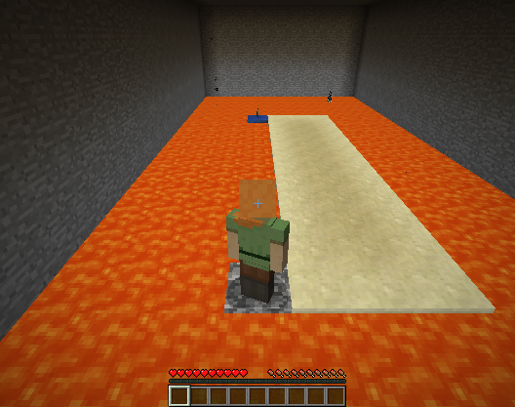
Mission XML
[...] <ServerHandlers>
<FlatWorldGenerator generatorString="3;7,220*1,5*3,2;3;,biome_1"/>
<DrawingDecorator> <!-- limits of our arena -->
<DrawCuboid x1="-2" y1="46" z1="-2" x2="7" y2="50“ z2="18" type="air" /> <!-- lava floor -->
<DrawCuboid x1="-2" y1="45" z1="-2" x2="7" y2="45“ z2="18" type="lava" /> <!-- floor of the arena -->
<DrawCuboid x1="1" y1="45" z1="1" x2="3" y2="45“ z2="12" type="sandstone" /> <!-- the starting marker -->
<DrawBlock x="4" y="45" z="1" type="cobblestone" /> <!-- the destination marker -->
<DrawBlock x="4" y="45" z="12" type="lapis_block" /> <!-- another destination marker -->
<DrawItem x="4" y="46" z="12" type="diamond" />
</DrawingDecorator>
<ServerQuitFromTimeUp timeLimitMs="10000"/>
<ServerQuitWhenAnyAgentFinishes/>
</ServerHandlers> [...]
Task-specific environment behaviour: world, exit conditions
Schema documentation: http://microsoft.github.io/malmo/0.17.0/Schemas/Mission.html

Slide 45
Mission XML
[...]
<AgentHandlers>
<ObservationFromFullStats/>
<VideoProducer want_depth="false">
<Width>640</Width>
<Height>480</Height>
</VideoProducer>
<DiscreteMovementCommands>
<ModifierList type="deny-list">
<command>attack</command>
</ModifierList>
</DiscreteMovementCommands>
<RewardForTouchingBlockType>
<Block reward="-100.0" type="lava“ behaviour="onceOnly"/>
<Block reward="100.0" type="lapis_block“ behaviour="onceOnly"/>
</RewardForTouchingBlockType>
<RewardForSendingCommand reward="-1"/>
<AgentQuitFromTouchingBlockType>
<Block type="lava" />
<Block type="lapis_block" />
</AgentQuitFromTouchingBlockType>
</AgentHandlers> [...]
Per-agent task definition:
available observations (e.g., video, chat, grid-world)
action space (discrete / continuous commands)
reward and quit conditions
Schema documentation: http://microsoft.github.io/malmo/0.17.0/Schemas/Mission.html

Slide 46
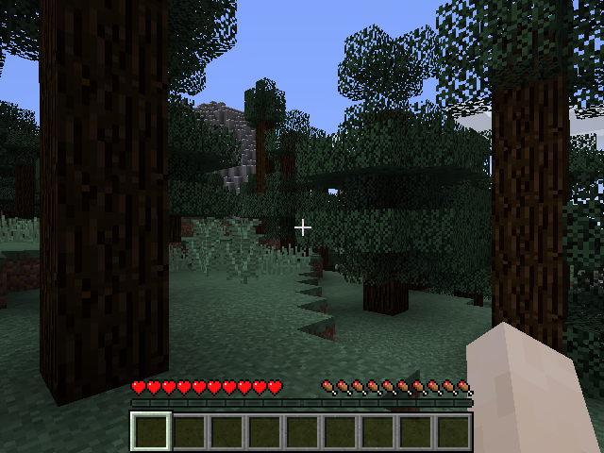
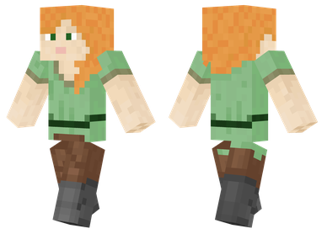
Use case 2: create an agent
Basic interaction loop: observe world state, act
actions
observations rewards

Slide 47
Python example
import MalmoAgent
import time
agent_host = MalmoPython.AgentHost()
my_mission = MalmoPython.MissionSpec(“my_mission.xml")
my_mission_record = MalmoPython.MissionSpec(“save.tgz")
my_mission_record.recordRewards()
agent_host.startMission( my_mission, my_mission_record )
// TO DO: wait for mission to start + check for errors
world_state = agent_host.peekWorldState()
while world_state.is_mission_running:
// interpret world state
world_state = agent_host.getWorldState()
for reward in world_state.rewards:
print "Summed reward:",reward.value
for observation in world_state.observations:
print "Observation:",observation.text
// act
agent_host.sendCommand( "move 1" )
agent_host.sendCommand( "turn 0.5" )
agent_host.sendCommand( “jump 1" )
time.sleep(0.1)
Initialize mission & recording, implement a basic interaction loop

Slide 48
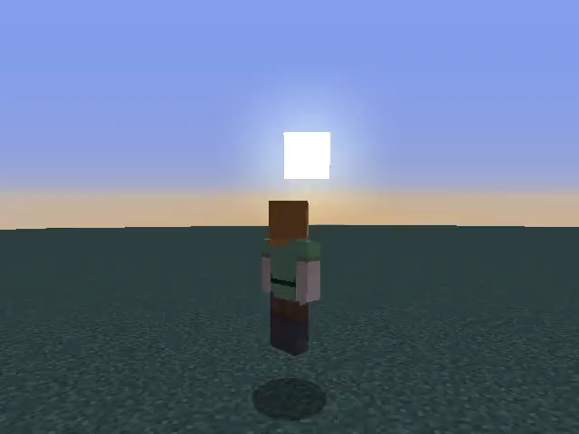
Python example
import MalmoAgent
import time
agent_host = MalmoPython.AgentHost()
my_mission = MalmoPython.MissionSpec(“my_mission.xml")
my_mission_record = MalmoPython.MissionSpec(“save.tgz")
my_mission_record.recordRewards()
agent_host.startMission( my_mission, my_mission_record )
// TO DO: wait for mission to start + check for errors
world_state = agent_host.peekWorldState()
while world_state.is_mission_running:
// interpret world state
world_state = agent_host.getWorldState()
for reward in world_state.rewards:
print "Summed reward:",reward.value
for observation in world_state.observations:
print "Observation:",observation.text
// act
agent_host.sendCommand( "move 1" )
agent_host.sendCommand( "turn 0.5" )
agent_host.sendCommand( “jump 1" )
time.sleep(0.1)
Initialize mission & recording, implement a basic interaction loop

Slide 49
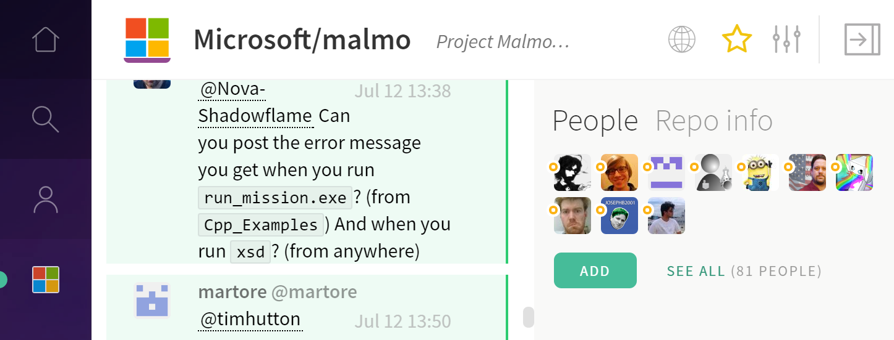
Advanced topics + resources
Malmo currently supports:
Continuous time + actions (actually, discrete behaviour is tricky)
Multi-agent missions (agents see, interact with each other, includes AI-AI & human-AI)
Observations from game state, grid, chat, video …
Resources:
Tutorial: https://github.com/Microsoft/malmo/blob/master/Malmo/samples/Python_examples/Tutorial.pdf
Documentation: http://microsoft.github.io/malmo/
Blog: http://microsoft.github.io/malmo/blog
Gitter chat: https://gitter.im/Microsoft/malmo

Slide 50
Takeaways
Interactive learning key ingredient for AI
Poses new challenges in design and evaluation of learning systems
Great progress in the last decade
Learn more:
http://aka.ms/mwt
https://www.microsoft.com/en-us/research/project/project-malmo/

